Slide 1




Not All Claims are Created Equal: Choosing the Right Statistical Approach to Assess Hypotheses
ACL 2020
Erfan Sadeqi-Azer (Indiana U → Google) Ashish Sabharwal (AI2) Dan Roth (UPenn).

Slide 2
About me
Join in 2013
Graduated in early 2019
Now: AI2, Seattle

Slide 3
This talk
Hypothesis testing/assessment:
A topic we’re [kind of] familiar with, by virtue of working in an empirical field.
There are holes in our understanding of these concepts and their usage.
Mix of new ideas and known stuff.

Slide 4
The Cycle of Empirical Research

Slide 5
The Cycle of Empirical Research
Empirical Observations

Slide 6
The Cycle of Empirical Research
????
Research
Problem
Empirical Observations

Slide 7
The Cycle of Empirical Research
Hypothesis, or a General Premise
????
Research
Problem
Empirical Observations

Slide 8
The Cycle of Empirical Research
Hypothesis, or a General Premise
????
Research
Problem
Assessment/
Verification
Empirical Observations

Slide 9
The Cycle of Empirical Research
Hypothesis, or a General Premise
????
Research
Problem
Assessment/
Verification
Empirical Observations

Slide 10
Hypotheses

Slide 11
Hypotheses
A prediction about how the world will behave if our idea is correct
Worded as an if-then statement
A hypothesis is a testable prediction
A hypothesis is a falsifiable statement
Terminology:
A hypothesis is never “proved”
But it could be “supported” by the evidence

Slide 12
Hypotheses
A prediction about how the world will behave if our idea is correct
Worded as an if-then statement
A hypothesis is a testable prediction
A hypothesis is a falsifiable statement
Terminology:
A hypothesis is never “proved”
But it could be “supported” by the evidence

Slide 13
Hypotheses
A prediction about how the world will behave if our idea is correct
Worded as an if-then statement
A hypothesis is a testable prediction
A hypothesis is a falsifiable statement
Terminology:
A hypothesis is never “proved”
But it could be “supported” by the evidence

Slide 14
Hypotheses
A prediction about how the world will behave if our idea is correct
Worded as an if-then statement
A hypothesis is a testable prediction
A hypothesis is a falsifiable statement
Terminology:
A hypothesis is never “proved”
But it could be “supported” by the evidence

Slide 15
Hypotheses
A prediction about how the world will behave if our idea is correct
Worded as an if-then statement
A hypothesis is a testable prediction
A hypothesis is a falsifiable statement
Terminology:
A hypothesis is never “proved”
But it could be “supported” by the evidence

Slide 17
Not a good statistical hypothesis

Slide 18
Not a good statistical hypothesis
2020

Slide 19
Not a good statistical hypothesis
2020
2020

Slide 20
Not a good statistical hypothesis
2020
2020
<
?

Slide 22
“I can always prepare a nice presentation, if I stay up the night before.”

Slide 23
A Typical AI Experiment
Hypothesis, or a General Premise
????
Research
Problem
Empirical Observations

Slide 24
A Typical AI Experiment
Hypothesis, or a General Premise
(Clark et al., 2018)
????
Research
Problem
System | Accuracy
Ⓐ | 72.4
Ⓑ | 68.9
Empirical Observations
|D|= 2376

Slide 25
A Typical AI Experiment
Hypothesis, or a General Premise
(Clark et al., 2018)
????
Research
Problem
System | Accuracy
Ⓐ | 72.4
Ⓑ | 68.9
Empirical Observations
|D|= 2376

Slide 26
A Typical AI Experiment
Can this apparent difference in performance be explained simply by random chance?
Do we have sufficient evidence to conclude that Ⓐ is in fact inherently stronger than Ⓑ on these datasets?
Hypothesis, or a General Premise
(Clark et al., 2018)
????
Research
Problem
System | Accuracy
Ⓐ | 72.4
Ⓑ | 68.9
Empirical Observations
|D|= 2376

Slide 27
A Typical AI Experiment
Can this apparent difference in performance be explained simply by random chance?
Do we have sufficient evidence to conclude that Ⓐ is in fact inherently stronger than Ⓑ on these datasets?
?
Hypothesis, or a General Premise
(Clark et al., 2018)
????
Research
Problem
System | Accuracy
Ⓐ | 72.4
Ⓑ | 68.9
Empirical Observations
|D|= 2376

Slide 28
A Typical AI Experiment: Example Hypotheses
System | Accuracy
Ⓐ | 72.4
Ⓑ | 68.9

Slide 29
A Typical AI Experiment: Example Hypotheses
System | Accuracy
Ⓐ | 72.4
Ⓑ | 68.9
H1*: Ⓐ and Ⓑ are inherently different, in the sense that if they were inherently identical, it would be highly unlikely to witness the observed 3.5% empirical gap.
H2*: Ⓐ and Ⓑ are inherently different, since with probability at least 95%, the inherent accuracy of Ⓐ exceeds that of Ⓑ by at least 𝛼%.

Slide 30
A Typical AI Experiment: Example Hypotheses
System | Accuracy
Ⓐ | 72.4
Ⓑ | 68.9
H1*: Ⓐ and Ⓑ are inherently different, in the sense that if they were inherently identical, it would be highly unlikely to witness the observed 3.5% empirical gap.
H2*: Ⓐ and Ⓑ are inherently different, since with probability at least 95%, the inherent accuracy of Ⓐ exceeds that of Ⓑ by at least 𝛼%.
* Under some statistical assumptions about sampling of the observations.

Slide 31
A Typical AI Experiment: Example Hypotheses
System | Accuracy
Ⓐ | 72.4
Ⓑ | 68.9
H1*: Ⓐ and Ⓑ are inherently different, in the sense that if they were inherently identical, it would be highly unlikely to witness the observed 3.5% empirical gap.
H2*: Ⓐ and Ⓑ are inherently different, since with probability at least 95%, the inherent accuracy of Ⓐ exceeds that of Ⓑ by at least 𝛼%.
* Under some statistical assumptions about sampling of the observations.

Slide 32
A Typical AI Experiment: Example Hypotheses
System | Accuracy
Ⓐ | 72.4
Ⓑ | 68.9
H1*: Ⓐ and Ⓑ are inherently different, in the sense that if they were inherently identical, it would be highly unlikely to witness the observed 3.5% empirical gap.
H2*: Ⓐ and Ⓑ are inherently different, since with probability at least 95%, the inherent accuracy of Ⓐ exceeds that of Ⓑ by at least 𝛼%.
* Under some statistical assumptions about sampling of the observations.

Slide 33
A Typical AI Experiment: Example Hypotheses
System | Accuracy
Ⓐ | 72.4
Ⓑ | 68.9
H1*: Ⓐ and Ⓑ are inherently different, in the sense that if they were inherently identical, it would be highly unlikely to witness the observed 3.5% empirical gap.
H2*: Ⓐ and Ⓑ are inherently different, since with probability at least 95%, the inherent accuracy of Ⓐ exceeds that of Ⓑ by at least 𝛼%.
* Under some statistical assumptions about sampling of the observations.

Slide 34
A Typical AI Experiment: Example Hypotheses
System | Accuracy
Ⓐ | 72.4
Ⓑ | 68.9
H1*: Ⓐ and Ⓑ are inherently different, in the sense that if they were inherently identical, it would be highly unlikely to witness the observed 3.5% empirical gap.
H2*: Ⓐ and Ⓑ are inherently different, since with probability at least 95%, the inherent accuracy of Ⓐ exceeds that of Ⓑ by at least 𝛼%.
* Under some statistical assumptions about sampling of the observations.

Slide 35
A Typical AI Experiment: Example Hypotheses
System | Accuracy
Ⓐ | 72.4
Ⓑ | 68.9
H1*: Ⓐ and Ⓑ are inherently different, in the sense that if they were inherently identical, it would be highly unlikely to witness the observed 3.5% empirical gap.
H2*: Ⓐ and Ⓑ are inherently different, since with probability at least 95%, the inherent accuracy of Ⓐ exceeds that of Ⓑ by at least 𝛼%.
* Under some statistical assumptions about sampling of the observations.

Slide 36
A Typical AI Experiment: Example Hypotheses
System | Accuracy
Ⓐ | 72.4
Ⓑ | 68.9
Spoiler Alert:
H1*: Ⓐ and Ⓑ are inherently different, in the sense that if they were inherently identical, it would be highly unlikely to witness the observed 3.5% empirical gap.
H2*: Ⓐ and Ⓑ are inherently different, since with probability at least 95%, the inherent accuracy of Ⓐ exceeds that of Ⓑ by at least 𝛼%.
* Under some statistical assumptions about sampling of the observations.

Slide 37
A Typical AI Experiment: Example Hypotheses
System | Accuracy
Ⓐ | 72.4
Ⓑ | 68.9
Spoiler Alert:
Almost everyone uses H1, even though it is harder to interpret.
H1*: Ⓐ and Ⓑ are inherently different, in the sense that if they were inherently identical, it would be highly unlikely to witness the observed 3.5% empirical gap.
H2*: Ⓐ and Ⓑ are inherently different, since with probability at least 95%, the inherent accuracy of Ⓐ exceeds that of Ⓑ by at least 𝛼%.
* Under some statistical assumptions about sampling of the observations.

Slide 38
A Typical AI Experiment: Example Hypotheses
System | Accuracy
Ⓐ | 72.4
Ⓑ | 68.9
Spoiler Alert:
Almost everyone uses H1, even though it is harder to interpret.
H1*: Ⓐ and Ⓑ are inherently different, in the sense that if they were inherently identical, it would be highly unlikely to witness the observed 3.5% empirical gap.
H2*: Ⓐ and Ⓑ are inherently different, since with probability at least 95%, the inherent accuracy of Ⓐ exceeds that of Ⓑ by at least 𝛼%.
* Under some statistical assumptions about sampling of the observations.
And many more . . .

Slide 39
Hypothesis-1
Research Question
Hypothesis-2
Hypothesis-3
…
Observation 1: There are many different hypotheses that could address a single research question.

Slide 40
Hypothesis vs Statistical Techniques
Research Question
Observation 2: Each hypothesis ought to be assessed with an appropriate statistical tool.

Slide 41
Hypothesis vs Statistical Techniques
Statistical Tool A
Hypothesis-1
Research Question
Statistical Tool B
Hypothesis-2
Statistical Tool C
Hypothesis-3
…
…
Observation 2: Each hypothesis ought to be assessed with an appropriate statistical tool.

Slide 42
Hypothesis vs Statistical Techniques
Statistical Tool A
Hypothesis-1
Research Question
Statistical Tool B
Hypothesis-2
Statistical Tool C
Hypothesis-3
…
…
Observation 2: Each hypothesis ought to be assessed with an appropriate statistical tool.
Corollary: Researchers should start with a hypothesis that best serves their goal and choose an appropriate statistical assessment accordingly.

Slide 43
Omission of hypotheses
Statistical Tool A
Hypothesis-1
Research Question
Statistical Tool B
Hypothesis-2
Statistical Tool C
Hypothesis-3
…
…

Slide 44
Omission of hypotheses
Observation 3: Somehow, we tend to forget about hypotheses
Statistical Tool A
Hypothesis-1
Research Question
Statistical Tool B
Hypothesis-2
Statistical Tool C
Hypothesis-3
…
…

Slide 45
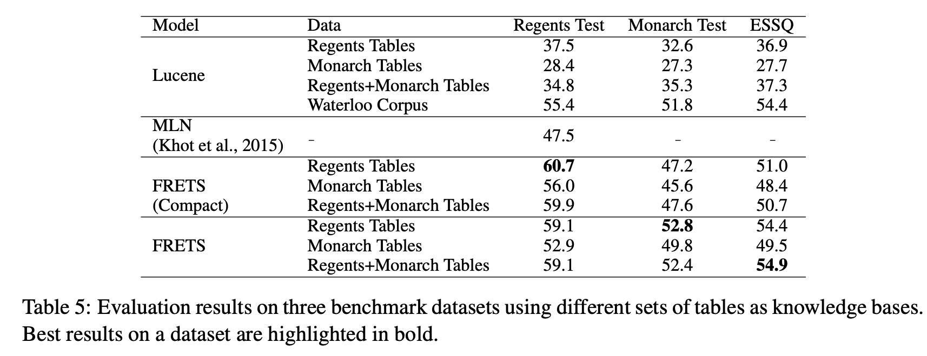
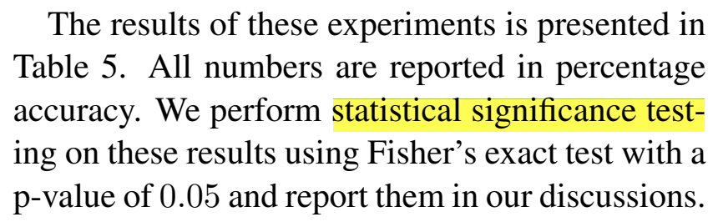
Omission of hypotheses
(EMNLP 2018)
Statistical Tool
Hypothesis
Research Question

Slide 46
Omission of hypotheses
(EMNLP 2018)
Ⓐ >> Ⓑ
Statistical Tool
Hypothesis
Research Question

Slide 47
Omission of hypotheses
(EMNLP 2018)
Ⓐ >> Ⓑ
Statistical Tool
Hypothesis
Research Question

Slide 48
Omission of hypotheses
(EMNLP 2018)
?
Ⓐ >> Ⓑ
Statistical Tool
Hypothesis
Research Question

Slide 49
Omission of hypotheses
(EMNLP 2018)
?
Ⓐ >> Ⓑ
Statistical Tool
Hypothesis
Research Question
Flawed practice: Many works use hypothesis assessment tests without knowing/stating their hypothesis.

Slide 50
Talk Summary & Statement
Motivated by several serious malpractices:
Under-reporting of hypotheses and how they address research questions.
Inability to interpret statistical tools or their results.
Lack of awareness about various alternatives; e.g., Bayesian assessment tools.
Research works should be explicit about:
(a) Their choice of hypothesis and,
(b) How selected statistical tool addresses this hypothesis.

Slide 51
Statistical tools in this work . . .
Frequentist
Bayesian
Binary/Categorical Decisions
Null-Hypothesis Significance Test
Bayes Factor
Uncertainty Estimations
Confidence Interval
Posterior Intervals
(Kruschke and Liddell, 2018)

Slide 52
Statistical tools in this work . . .
Frequentist
Bayesian
Binary/Categorical Decisions
Null-Hypothesis Significance Test
Bayes Factor
Uncertainty Estimations
Confidence Interval
Posterior Intervals
(Kruschke and Liddell, 2018)

Slide 53
Survey of the NLP Community

Slide 54
Survey of the NLP Community
A questionnaire containing general and specific questions about significance assessment tools
Sent it to over 400 researchers randomly selected from ACL’18 proceedings
~50 individuals responded

Slide 55
Survey of the NLP Community
A questionnaire containing general and specific questions about significance assessment tools
Sent it to over 400 researchers randomly selected from ACL’18 proceedings
~50 individuals responded

Slide 56
Survey of the NLP Community
A questionnaire containing general and specific questions about significance assessment tools
Sent it to over 400 researchers randomly selected from ACL’18 proceedings
~50 individuals responded

Slide 57

Survey of the NLP Community
A questionnaire containing general and specific questions about significance assessment tools
Sent it to over 400 researchers randomly selected from ACL’18 proceedings
~50 individuals responded

Slide 58
Survey of the NLP Community
“I have learned about statistical hypothesis testing/assessment (via taking classes or reading it from other places).”

Slide 59
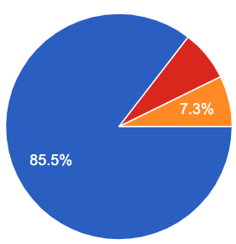
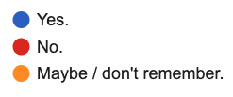
Survey of the NLP Community
“I have learned about statistical hypothesis testing/assessment (via taking classes or reading it from other places).”

Slide 60
Participants in Our Survey
“I have used "hypothesis testing" in the past (in a homework, a paper, etc.)”

Slide 61
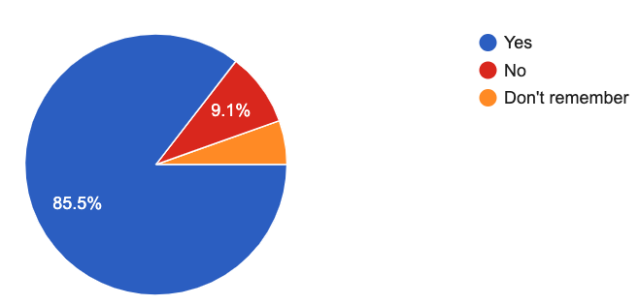
Participants in Our Survey
“I have used "hypothesis testing" in the past (in a homework, a paper, etc.)”

Slide 62
Participants in Our Survey
“I am not a robot”

Slide 63
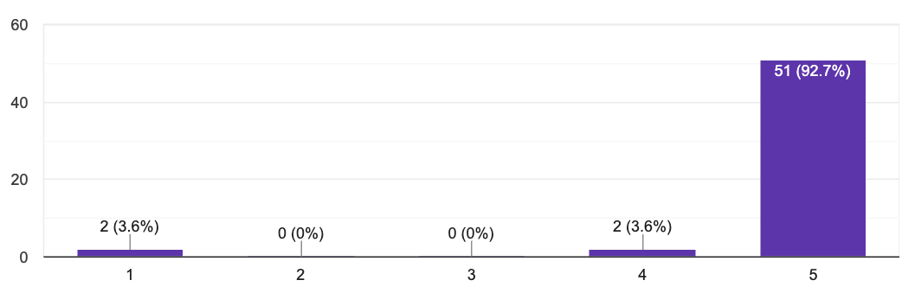
Participants in Our Survey
“I am not a robot”

Slide 64
Participants in Our Survey
“I am not a robot”

Slide 65
Participants in Our Survey
“I am not a robot”

Slide 66
Trends and Patterns in the field
Study NLP conference papers: ACL’18 papers (439 papers)
How many papers did use significance testing?
Frequentist
Bayesian
Binary Decision
Null-Hypothesis Significance Test
Bayes Factor
Uncertainty Estimations
Confidence Interval
Posterior Intervals

Slide 67
Trends and Patterns in the field
Study NLP conference papers: ACL’18 papers (439 papers)
How many papers did use significance testing?
Frequentist
Bayesian
73
Binary Decision
Null-Hypothesis Significance Test
Bayes Factor
Uncertainty Estimations
Confidence Interval
Posterior Intervals

Slide 68
Trends and Patterns in the field
Study NLP conference papers: ACL’18 papers (439 papers)
How many papers did use significance testing?
Frequentist
Bayesian
73
Binary Decision
Null-Hypothesis Significance Test
Bayes Factor
Uncertainty Estimations
Confidence Interval
Posterior Intervals
6

Slide 69
Trends and Patterns in the field
Study NLP conference papers: ACL’18 papers (439 papers)
How many papers did use significance testing?
Frequentist
Bayesian
73
0
Binary Decision
Null-Hypothesis Significance Test
Bayes Factor
Uncertainty Estimations
Confidence Interval
Posterior Intervals
6

Slide 70
Trends and Patterns in the field
Study NLP conference papers: ACL’18 papers (439 papers)
How many papers did use significance testing?
Frequentist
Bayesian
73
0
Binary Decision
Null-Hypothesis Significance Test
Bayes Factor
Uncertainty Estimations
Confidence Interval
Posterior Intervals
6
0

Slide 71
Trends and Patterns in the field
Study NLP conference papers: ACL’18 papers (439 papers)
How many papers did use significance testing?
Frequentist
Bayesian
The overuse of NHST is why we focus on its issues.
All techniques have their own limitations and ought to be used with this in mind.
73
0
Binary Decision
Null-Hypothesis Significance Test
Bayes Factor
Uncertainty Estimations
Confidence Interval
Posterior Intervals
6
0

Slide 72
Frequentist
Bayesian
Binary/Categorical Decisions
Null-Hypothesis Significance Test
Bayes Factor
Uncertainty Estimations
Confidence Interval
Posterior Intervals

Slide 73
Notation

Slide 74
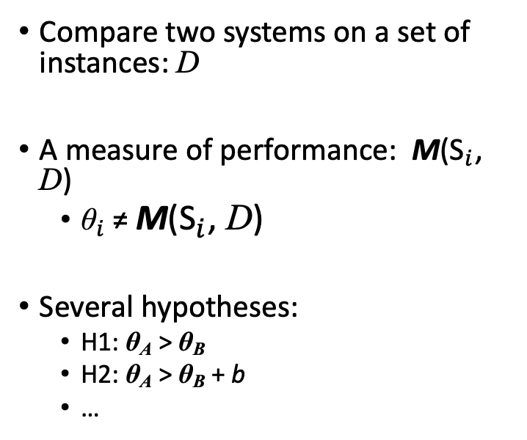
Notation
Compare two systems on a set of instances: D
A measure of performance: M(${\text{S}}_{i}$, D)
${\text{θ}}_{i}$≠ M(${\text{S}}_{i}$, D)
Several hypotheses:
H1: θ_{A} > θ_{B}
H2: θ_{A} > θ_{B} + b
…

Slide 75
Notation
Input instances: D
Compare two systems on a set of instances: D
A measure of performance: M(${\text{S}}_{i}$, D)
${\text{θ}}_{i}$≠ M(${\text{S}}_{i}$, D)
Several hypotheses:
H1: θ_{A} > θ_{B}
H2: θ_{A} > θ_{B} + b
…
SA
SA

Slide 76
Notation
Input instances: D
Compare two systems on a set of instances: D
A measure of performance: M(${\text{S}}_{i}$, D)
${\text{θ}}_{i}$≠ M(${\text{S}}_{i}$, D)
Several hypotheses:
H1: θ_{A} > θ_{B}
H2: θ_{A} > θ_{B} + b
…
SA
SA

Slide 77
Notation
Input instances: D
Compare two systems on a set of instances: D
A measure of performance: M(${\text{S}}_{i}$, D)
${\text{θ}}_{i}$≠ M(${\text{S}}_{i}$, D)
Several hypotheses:
H1: θ_{A} > θ_{B}
H2: θ_{A} > θ_{B} + b
…
SA
SA
Metric M

Slide 78
Notation
Input instances: D
Compare two systems on a set of instances: D
A measure of performance: M(${\text{S}}_{i}$, D)
${\text{θ}}_{i}$≠ M(${\text{S}}_{i}$, D)
Several hypotheses:
H1: θ_{A} > θ_{B}
H2: θ_{A} > θ_{B} + b
…
SA
SA
Metric M
Observations

Slide 79
Notation
Input instances: D
Claims about the inherent properties θ_{A},θ_{B} of the two systems.
Compare two systems on a set of instances: D
A measure of performance: M(${\text{S}}_{i}$, D)
${\text{θ}}_{i}$≠ M(${\text{S}}_{i}$, D)
Several hypotheses:
H1: θ_{A} > θ_{B}
H2: θ_{A} > θ_{B} + b
…
SA
SA
Metric M
Observations

Slide 80
Notation
Input instances: D
Claims about the inherent properties θ_{A},θ_{B} of the two systems.
Compare two systems on a set of instances: D
A measure of performance: M(${\text{S}}_{i}$, D)
${\text{θ}}_{i}$≠ M(${\text{S}}_{i}$, D)
Several hypotheses:
H1: θ_{A} > θ_{B}
H2: θ_{A} > θ_{B} + b
…
SA
SA
Metric M
Observations

Slide 81
Notation
Input instances: D
Claims about the inherent properties θ_{A},θ_{B} of the two systems.
Compare two systems on a set of instances: D
A measure of performance: M(${\text{S}}_{i}$, D)
${\text{θ}}_{i}$≠ M(${\text{S}}_{i}$, D)
Several hypotheses:
H1: θ_{A} > θ_{B}
H2: θ_{A} > θ_{B} + b
…
SA
SA
Metric M
Hypotheses
Observations

Slide 82
Notation
Input instances: D
Claims about the inherent properties θ_{A},θ_{B} of the two systems.
Compare two systems on a set of instances: D
A measure of performance: M(${\text{S}}_{i}$, D)
${\text{θ}}_{i}$≠ M(${\text{S}}_{i}$, D)
Several hypotheses:
H1: θ_{A} > θ_{B}
H2: θ_{A} > θ_{B} + b
…
SA
SA
Metric M
Hypotheses
Observations

Slide 83
Notation
Input instances: D
Claims about the inherent properties θ_{A},θ_{B} of the two systems.
Compare two systems on a set of instances: D
A measure of performance: M(${\text{S}}_{i}$, D)
${\text{θ}}_{i}$≠ M(${\text{S}}_{i}$, D)
Several hypotheses:
H1: θ_{A} > θ_{B}
H2: θ_{A} > θ_{B} + b
…
SA
SA
Metric M
Hypotheses
Observations

Slide 84
Notation
Input instances: D
Claims about the inherent properties θ_{A},θ_{B} of the two systems.
Compare two systems on a set of instances: D
A measure of performance: M(${\text{S}}_{i}$, D)
${\text{θ}}_{i}$≠ M(${\text{S}}_{i}$, D)
Several hypotheses:
H1: θ_{A} > θ_{B}
H2: θ_{A} > θ_{B} + b
…
SA
SA
Metric M
Hypotheses
Observations

Slide 85
Notation
Input instances: D
Claims about the inherent properties θ_{A},θ_{B} of the two systems.
Compare two systems on a set of instances: D
A measure of performance: M(${\text{S}}_{i}$, D)
${\text{θ}}_{i}$≠ M(${\text{S}}_{i}$, D)
Several hypotheses:
H1: θ_{A} > θ_{B}
H2: θ_{A} > θ_{B} + b
…
SA
SA
Metric M
Hypotheses
Observations

Slide 86
Notation
Input instances: D
Claims about the inherent properties θ_{A},θ_{B} of the two systems.
Compare two systems on a set of instances: D
A measure of performance: M(${\text{S}}_{i}$, D)
${\text{θ}}_{i}$≠ M(${\text{S}}_{i}$, D)
Several hypotheses:
H1: θ_{A} > θ_{B}
H2: θ_{A} > θ_{B} + b
…
SA
SA
Metric M
Hypotheses
Hypothesis Assessment
Observations

Slide 87
Notation
Input instances: D
Claims about the inherent properties θ_{A},θ_{B} of the two systems.
Compare two systems on a set of instances: D
A measure of performance: M(${\text{S}}_{i}$, D)
${\text{θ}}_{i}$≠ M(${\text{S}}_{i}$, D)
Several hypotheses:
H1: θ_{A} > θ_{B}
H2: θ_{A} > θ_{B} + b
…
SA
SA
Metric M
Hypotheses
Hypothesis Assessment
Observations
Conclusions validating
(or not) the hypotheses.

Slide 88
Null-Hypothesis Significance Testing
(Søgaard et al., 2014; Koehn, 2004; Dror and Reichart, 2018)

Slide 89
Null-Hypothesis Significance Testing
The goal is to decide whether the inverse of your claim can be rejected.
Make a hypothesis (that you want it to be rejected): null-hypothesis.
Assume that null-hypothesis is correct.
Calculate the probability of getting an outcome as “extreme” or more than the observed outcome.
This probability is called a “p-value.”
(Søgaard et al., 2014; Koehn, 2004; Dror and Reichart, 2018)

Slide 90
Null-Hypothesis Significance Testing
The goal is to decide whether the inverse of your claim can be rejected.
Make a hypothesis (that you want it to be rejected): null-hypothesis.
Assume that null-hypothesis is correct.
Calculate the probability of getting an outcome as “extreme” or more than the observed outcome.
This probability is called a “p-value.”
(Søgaard et al., 2014; Koehn, 2004; Dror and Reichart, 2018)

Slide 91
Null-Hypothesis Significance Testing
The goal is to decide whether the inverse of your claim can be rejected.
Make a hypothesis (that you want it to be rejected): null-hypothesis.
Assume that null-hypothesis is correct.
Calculate the probability of getting an outcome as “extreme” or more than the observed outcome.
This probability is called a “p-value.”
H₀: θ_{A} =θ_{B}
(Søgaard et al., 2014; Koehn, 2004; Dror and Reichart, 2018)

Slide 92
Null-Hypothesis Significance Testing
The goal is to decide whether the inverse of your claim can be rejected.
Make a hypothesis (that you want it to be rejected): null-hypothesis.
Assume that null-hypothesis is correct.
Calculate the probability of getting an outcome as “extreme” or more than the observed outcome.
This probability is called a “p-value.”
H₀: θ_{A} =θ_{B}
(Søgaard et al., 2014; Koehn, 2004; Dror and Reichart, 2018)

Slide 93
Null-Hypothesis Significance Testing
The goal is to decide whether the inverse of your claim can be rejected.
Make a hypothesis (that you want it to be rejected): null-hypothesis.
Assume that null-hypothesis is correct.
Calculate the probability of getting an outcome as “extreme” or more than the observed outcome.
This probability is called a “p-value.”
H₀: θ_{A} =θ_{B}
e.g., a bigger accuracy improvement.
(Søgaard et al., 2014; Koehn, 2004; Dror and Reichart, 2018)

Slide 94
Null-Hypothesis Significance Testing
The goal is to decide whether the inverse of your claim can be rejected.
Make a hypothesis (that you want it to be rejected): null-hypothesis.
Assume that null-hypothesis is correct.
Calculate the probability of getting an outcome as “extreme” or more than the observed outcome.
This probability is called a “p-value.”
H₀: θ_{A} =θ_{B}
e.g., a bigger accuracy improvement.
(Søgaard et al., 2014; Koehn, 2004; Dror and Reichart, 2018)

Slide 95
Null-Hypothesis Significance Testing: Example
System | Accuracy
Ⓐ | 72.4%
Ⓑ | 68.9%

Slide 96
Null-Hypothesis Significance Testing: Example
Hypothesis H1: θ_{A} > θ_{B}
System | Accuracy
Ⓐ | 72.4%
Ⓑ | 68.9%

Slide 97
Null-Hypothesis Significance Testing: Example
Hypothesis H1: θ_{A} > θ_{B}
Null-Hypothesis H0: θ_{A} = θ_{B}
System | Accuracy
Ⓐ | 72.4%
Ⓑ | 68.9%

Slide 98
Null-Hypothesis Significance Testing: Example
Hypothesis H1: θ_{A} > θ_{B}
Null-Hypothesis H0: θ_{A} = θ_{B}
System | Accuracy
Ⓐ | 72.4%
Ⓑ | 68.9%

Slide 99
Null-Hypothesis Significance Testing: Example
Hypothesis H1: θ_{A} > θ_{B}
Null-Hypothesis H0: θ_{A} = θ_{B}
System | Accuracy
Ⓐ | 72.4%
Ⓑ | 68.9%

Slide 100
Null-Hypothesis Significance Testing: Example
Hypothesis H1: θ_{A} > θ_{B}
Null-Hypothesis H0: θ_{A} = θ_{B}
System | Accuracy
Ⓐ | 72.4%
Ⓑ | 68.9%

Slide 101
Null-Hypothesis Significance Testing: Example
Hypothesis H1: θ_{A} > θ_{B}
Null-Hypothesis H0: θ_{A} = θ_{B}
System | Accuracy
Ⓐ | 72.4%
Ⓑ | 68.9%

Slide 102
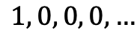
Null-Hypothesis Significance Testing: Example
Hypothesis H1: θ_{A} > θ_{B}
Null-Hypothesis H0: θ_{A} = θ_{B}
System | Accuracy
Ⓐ | 72.4%
Ⓑ | 68.9%
$$1, 0, 0, 0,…$$

Slide 103
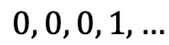
Null-Hypothesis Significance Testing: Example
Hypothesis H1: θ_{A} > θ_{B}
Null-Hypothesis H0: θ_{A} = θ_{B}
System | Accuracy
Ⓐ | 72.4%
Ⓑ | 68.9%
$$1, 0, 0, 0,…$$
$$0, 0, 0, 1,…$$

Slide 104
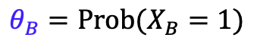
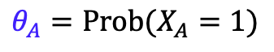
Null-Hypothesis Significance Testing: Example
Hypothesis H1: θ_{A} > θ_{B}
Null-Hypothesis H0: θ_{A} = θ_{B}
$$θ_{A}=Prob(X_{A}=1)$$
System | Accuracy
Ⓐ | 72.4%
Ⓑ | 68.9%
$$1, 0, 0, 0,…$$
$$θ_{B}=Prob(X_{B}=1)$$
$$0, 0, 0, 1,…$$

Slide 105

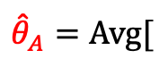
Null-Hypothesis Significance Testing: Example
Hypothesis H1: θ_{A} > θ_{B}
Null-Hypothesis H0: θ_{A} = θ_{B}
$$θ_{A}=Prob(X_{A}=1)$$
System | Accuracy
Ⓐ | 72.4%
Ⓑ | 68.9%
$${\hat{θ}}_{A}=Avg[$$
$$]$$
$$1, 0, 0, 0,…$$
$$θ_{B}=Prob(X_{B}=1)$$
$$0, 0, 0, 1,…$$

Slide 106
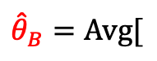

Null-Hypothesis Significance Testing: Example
Hypothesis H1: θ_{A} > θ_{B}
Null-Hypothesis H0: θ_{A} = θ_{B}
$$θ_{A}=Prob(X_{A}=1)$$
System | Accuracy
Ⓐ | 72.4%
Ⓑ | 68.9%
$${\hat{θ}}_{A}=Avg[$$
$$]$$
$$1, 0, 0, 0,…$$
$$θ_{B}=Prob(X_{B}=1)$$
$${\hat{θ}}_{B}=Avg[$$
$$0, 0, 0, 1,…$$
$$]$$

Slide 107
Null-Hypothesis Significance Testing: Example
Hypothesis H1: θ_{A} > θ_{B}
Null-Hypothesis H0: θ_{A} = θ_{B}
$$θ_{A}=Prob(X_{A}=1)$$
System | Accuracy
Ⓐ | 72.4%
Ⓑ | 68.9%
$${\hat{θ}}_{A}=Avg[$$
$$]$$
$$1, 0, 0, 0,…$$
$$θ_{B}=Prob(X_{B}=1)$$
$${\hat{θ}}_{B}=Avg[$$
$$0, 0, 0, 1,…$$
$$]$$
P-value=

Slide 108
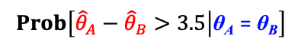
Null-Hypothesis Significance Testing: Example
Hypothesis H1: θ_{A} > θ_{B}
Null-Hypothesis H0: θ_{A} = θ_{B}
$$θ_{A}=Prob(X_{A}=1)$$
System | Accuracy
Ⓐ | 72.4%
Ⓑ | 68.9%
$${\hat{θ}}_{A}=Avg[$$
$$]$$
$$1, 0, 0, 0,…$$
$$θ_{B}=Prob(X_{B}=1)$$
$${\hat{θ}}_{B}=Avg[$$
$$0, 0, 0, 1,…$$
$$]$$
P-value=
$$Prob\left[{\hat{θ}}_{A}−{\hat{θ}}_{B}>3.5 | \text{θ}\text{A} \text{=} \text{θ}\text{B}\right]$$

Slide 109
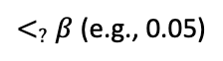
Null-Hypothesis Significance Testing: Example
Hypothesis H1: θ_{A} > θ_{B}
Null-Hypothesis H0: θ_{A} = θ_{B}
$$θ_{A}=Prob(X_{A}=1)$$
System | Accuracy
Ⓐ | 72.4%
Ⓑ | 68.9%
$${\hat{θ}}_{A}=Avg[$$
$$]$$
$$1, 0, 0, 0,…$$
$$θ_{B}=Prob(X_{B}=1)$$
$${\hat{θ}}_{B}=Avg[$$
$$0, 0, 0, 1,…$$
$$]$$
P-value=
$$Prob\left[{\hat{θ}}_{A}−{\hat{θ}}_{B}>3.5 | \text{θ}\text{A} \text{=} \text{θ}\text{B}\right]$$
$<_{?}$ $β$ (e.g., 0.05)

Slide 110
Null-Hypothesis Significance Testing: Example
Hypothesis H1: θ_{A} > θ_{B}
Null-Hypothesis H0: θ_{A} = θ_{B}
$$θ_{A}=Prob(X_{A}=1)$$
System | Accuracy
Ⓐ | 72.4%
Ⓑ | 68.9%
$${\hat{θ}}_{A}=Avg[$$
$$]$$
$$1, 0, 0, 0,…$$
$$θ_{B}=Prob(X_{B}=1)$$
$${\hat{θ}}_{B}=Avg[$$
$$0, 0, 0, 1,…$$
$$]$$
One-sided z-test
P-value=
$$Prob\left[{\hat{θ}}_{A}−{\hat{θ}}_{B}>3.5 | \text{θ}\text{A} \text{=} \text{θ}\text{B}\right]$$
$<_{?}$ $β$ (e.g., 0.05)

Slide 111
Interpreting p-values

Slide 112
Interpreting p-values
Pretty complex notion!

Slide 113
Interpreting p-values
Pretty complex notion!
“The probability of obtaining test results at least as extreme as the results actually observed during the test, assuming that the null-hypothesis is correct.” --your favorite statistics textbook

Slide 114
Interpreting p-value
If p < 0.05, the null-hypothesis has only a 5% chance of being true
(Demsar, 2008; Goodman, 2008)

Slide 115
Interpreting p-value
If p < 0.05, the null-hypothesis has only a 5% chance of being true
(Demsar, 2008; Goodman, 2008)

Slide 116
Interpreting p-value
If p < 0.05, the null-hypothesis has only a 5% chance of being true
Remember that p-value is defined with the assumption that null-hypothesis is correct.
… but it does not tell anything about the likeliness of the null-hypothesis.
(Demsar, 2008; Goodman, 2008)

Slide 117
Interpreting p-value
If p < 0.05, the null-hypothesis has only a 5% chance of being true
Remember that p-value is defined with the assumption that null-hypothesis is correct.
… but it does not tell anything about the likeliness of the null-hypothesis.
(Demsar, 2008; Goodman, 2008)

Slide 118
Interpreting p-value
A statistically significant result (p < 0.05) indicates a large/notable difference between two systems.
(Demsar, 2008; Goodman, 2008)

Slide 119
Interpreting p-value
A statistically significant result (p < 0.05) indicates a large/notable difference between two systems.
(Demsar, 2008; Goodman, 2008)

Slide 120
Interpreting p-value
A statistically significant result (p < 0.05) indicates a large/notable difference between two systems.
P-value only indicates strict superiority and provides no information about the margin of the effect.
(Demsar, 2008; Goodman, 2008)

Slide 121
Participants in Our Survey
“I know p-values and I know how to interpret them.”

Slide 122
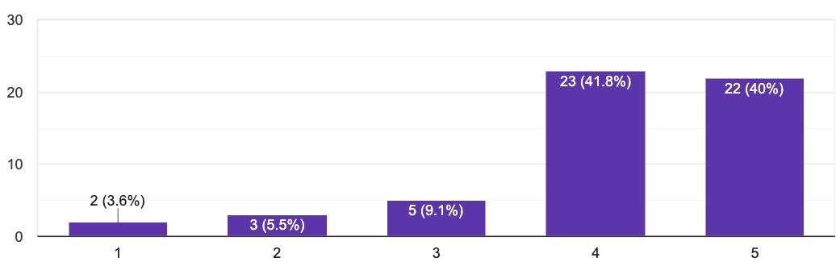
Participants in Our Survey
“I know p-values and I know how to interpret them.”

Slide 123
A Survey Question: Interpreting P-value
classifier-A | 38%
classifier-B | 45%

Slide 124
A Survey Question: Interpreting P-value
The authors claim that the improvement of classifier-B over classifier-A is “statistically significant” with a significance level of 0.01. Which of the followings is correct?
The probability of observing a margin 7% is at most 0.01, assuming that the two classifiers inherently have the same performance.
With a probability 99% classifier-2 will have a higher performance than classifier-1.
classifier-A | 38%
classifier-B | 45%

Slide 125
A Survey Question: Interpreting P-value
The authors claim that the improvement of classifier-B over classifier-A is “statistically significant” with a significance level of 0.01. Which of the followings is correct?
The probability of observing a margin 7% is at most 0.01, assuming that the two classifiers inherently have the same performance.
With a probability 99% classifier-2 will have a higher performance than classifier-1.
classifier-A | 38%
classifier-B | 45%

Slide 126
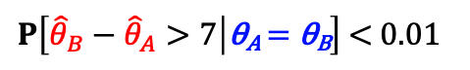
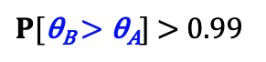
A Survey Question: Interpreting P-value
The authors claim that the improvement of classifier-B over classifier-A is “statistically significant” with a significance level of 0.01. Which of the followings is correct?
The probability of observing a margin 7% is at most 0.01, assuming that the two classifiers inherently have the same performance.
With a probability 99% classifier-2 will have a higher performance than classifier-1.
classifier-A | 38%
classifier-B | 45%
$P\left[{\hat{θ}}_{B}−{\hat{θ}}_{A}>7 | \text{θ}\text{A} \text{=} \text{θ}\text{B}\right]$ < 0.01
$P[\text{θ}\text{B} \text{>} \text{θ}\text{A}]$ > 0.99

Slide 127
A Survey Question: Interpreting P-value
The authors claim that the improvement of classifier-B over classifier-A is “statistically significant” with a significance level of 0.01. Which of the followings is correct?
The probability of observing a margin 7% is at most 0.01, assuming that the two classifiers inherently have the same performance.
With a probability 99% classifier-2 will have a higher performance than classifier-1.
classifier-A | 38%
classifier-B | 45%
23%
$P\left[{\hat{θ}}_{B}−{\hat{θ}}_{A}>7 | \text{θ}\text{A} \text{=} \text{θ}\text{B}\right]$ < 0.01
30%
$P[\text{θ}\text{B} \text{>} \text{θ}\text{A}]$ > 0.99
🤦

Slide 128
Intermediate Summary
Frequentist
Bayesian
Binary Decision
Null-Hypothesis Significance Test
Bayes Factor
Uncertainty Estimations
Confidence Interval
Posterior Intervals

Slide 129
Intermediate Summary
Null-Hypothesis Significance Tests are the most popular choice among NLP practitioners. Meanwhile, they’re difficult to understand and highly prone to misunderstanding.
Frequentist
Bayesian
Binary Decision
Null-Hypothesis Significance Test
Bayes Factor
Uncertainty Estimations
Confidence Interval
Posterior Intervals

Slide 130
Intermediate Summary
Null-Hypothesis Significance Tests are the most popular choice among NLP practitioners. Meanwhile, they’re difficult to understand and highly prone to misunderstanding.
P-values do not provide probability estimates on two classifiers being different (or equal).
Frequentist
Bayesian
Binary Decision
Null-Hypothesis Significance Test
Bayes Factor
Uncertainty Estimations
Confidence Interval
Posterior Intervals

Slide 131
Intermediate Summary
Null-Hypothesis Significance Tests are the most popular choice among NLP practitioners. Meanwhile, they’re difficult to understand and highly prone to misunderstanding.
P-values do not provide probability estimates on two classifiers being different (or equal).
Frequentist
Bayesian
Binary Decision
Null-Hypothesis Significance Test
Bayes Factor
Statistical significance is different than practical significance.
Uncertainty Estimations
Confidence Interval
Posterior Intervals

Slide 132
Frequentist
Bayesian
Binary/Categorical Decisions
Null-Hypothesis Significance Test
Bayes Factor
Uncertainty Estimations
Confidence Interval
Posterior Intervals

Slide 133
Frequentist
Bayesian
Binary/Categorical Decisions
Null-Hypothesis Significance Test
Bayes Factor
Uncertainty Estimations
Confidence Interval
Posterior Intervals

Slide 134
Posterior Intervals
Based on Bayesian inference framework.
(Thomas Bayes 1702-1761)

Slide 135
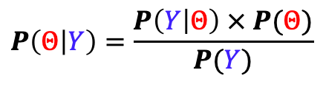
Posterior Intervals
$$P\left(Θ | Y\right)=\frac{P\left(Y | Θ\right) × P(Θ)}{P(Y)}$$

Slide 136
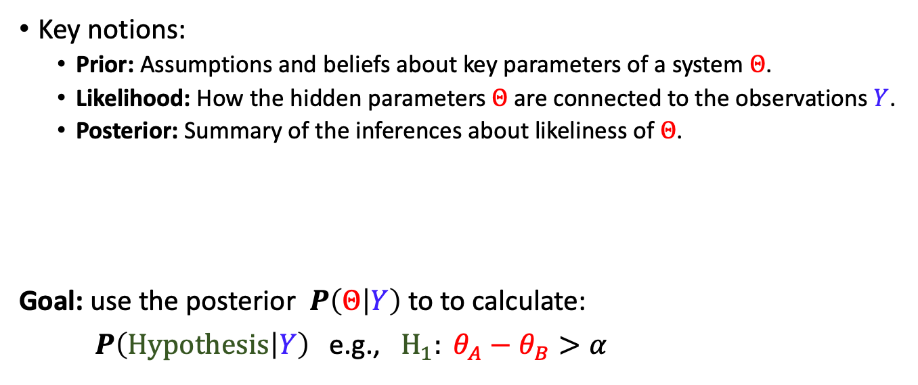
Posterior Intervals
Key notions:
Prior: Assumptions and beliefs about key parameters of a system $Θ$.
Likelihood: How the hidden parameters $Θ$ are connected to the observations $Y$.
Posterior: Summary of the inferences about likeliness of $Θ$.
Goal: use the posterior $P\left(Θ | Y\right)$to to calculate:
$P\left(Hypothesis | Y\right)$e.g., $H_{1}: θ_{A}−θ_{B}>α$
$$P\left(Θ | Y\right)=\frac{P\left(Y | Θ\right) × P(Θ)}{P(Y)}$$

Slide 137
Posterior Intervals
Key notions:
Prior: Assumptions and beliefs about key parameters of a system $Θ$.
Likelihood: How the hidden parameters $Θ$ are connected to the observations $Y$.
Posterior: Summary of the inferences about likeliness of $Θ$.
Goal: use the posterior $P\left(Θ | Y\right)$to to calculate:
$P\left(Hypothesis | Y\right)$e.g., $H_{1}: θ_{A}−θ_{B}>α$
$$P\left(Θ | Y\right)=\frac{P\left(Y | Θ\right) × P(Θ)}{P(Y)}$$

Slide 138
Posterior Intervals
Key notions:
Prior: Assumptions and beliefs about key parameters of a system $Θ$.
Likelihood: How the hidden parameters $Θ$ are connected to the observations $Y$.
Posterior: Summary of the inferences about likeliness of $Θ$.
Goal: use the posterior $P\left(Θ | Y\right)$to to calculate:
$P\left(Hypothesis | Y\right)$e.g., $H_{1}: θ_{A}−θ_{B}>α$
$$P\left(Θ | Y\right)=\frac{P\left(Y | Θ\right) × P(Θ)}{P(Y)}$$

Slide 139
Posterior Intervals
Key notions:
Prior: Assumptions and beliefs about key parameters of a system $Θ$.
Likelihood: How the hidden parameters $Θ$ are connected to the observations $Y$.
Posterior: Summary of the inferences about likeliness of $Θ$.
Goal: use the posterior $P\left(Θ | Y\right)$to to calculate:
$P\left(Hypothesis | Y\right)$e.g., $H_{1}: θ_{A}−θ_{B}>α$
$$P\left(Θ | Y\right)=\frac{P\left(Y | Θ\right) × P(Θ)}{P(Y)}$$

Slide 140
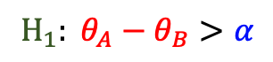
Posterior Intervals: Example
System | Accuracy
Ⓐ | 72.4
Ⓑ | 68.9
$$H_{1}: θ_{A}−θ_{B}>α$$

Slide 141
Posterior Intervals: Example
System | Accuracy
Ⓐ | 72.4
Ⓑ | 68.9
$$H_{1}: θ_{A}−θ_{B}>α$$
Ⓐ
Ⓑ

Slide 142
Posterior Intervals: Example
System | Accuracy
Ⓐ | 72.4
Ⓑ | 68.9
$$H_{1}: θ_{A}−θ_{B}>α$$
Ⓐ
Ⓑ

Slide 143
Posterior Intervals: Example
System | Accuracy
Ⓐ | 72.4
Ⓑ | 68.9
$$H_{1}: θ_{A}−θ_{B}>α$$
Ⓐ
Ⓑ

Slide 144
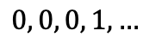
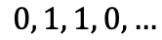
Posterior Intervals: Example
System | Accuracy
Ⓐ | 72.4
Ⓑ | 68.9
$$H_{1}: θ_{A}−θ_{B}>α$$
Ⓐ
$$0, 1, 1, 0,…$$
Ⓑ
$$0, 0, 0, 1,…$$

Slide 145
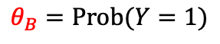
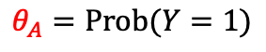
Posterior Intervals: Example
System | Accuracy
Ⓐ | 72.4
Ⓑ | 68.9
$$H_{1}: θ_{A}−θ_{B}>α$$
$$θ_{A}=Prob(Y=1)$$
Ⓐ
$$0, 1, 1, 0,…$$
$$θ_{B}=Prob(Y=1)$$
Ⓑ
$$0, 0, 0, 1,…$$

Slide 146
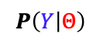
Posterior Intervals: Example
System | Accuracy
Ⓐ | 72.4
Ⓑ | 68.9
$$H_{1}: θ_{A}−θ_{B}>α$$
$$θ_{A}=Prob(Y=1)$$
Ⓐ
$$0, 1, 1, 0,…$$
$$θ_{B}=Prob(Y=1)$$
Ⓑ
$$0, 0, 0, 1,…$$
$$P\left(Y | Θ\right)$$

Slide 147
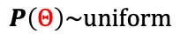
Posterior Intervals: Example
System | Accuracy
Ⓐ | 72.4
Ⓑ | 68.9
$$H_{1}: θ_{A}−θ_{B}>α$$
$$θ_{A}=Prob(Y=1)$$
Ⓐ
$$0, 1, 1, 0,…$$
$$θ_{B}=Prob(Y=1)$$
Ⓑ
$$0, 0, 0, 1,…$$
$$P\left(Y | Θ\right)$$
⊕
$$P\left(Θ\right)\sim uniform$$

Slide 148
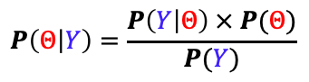
Posterior Intervals: Example
System | Accuracy
Ⓐ | 72.4
Ⓑ | 68.9
$$H_{1}: θ_{A}−θ_{B}>α$$
$$θ_{A}=Prob(Y=1)$$
Ⓐ
$$0, 1, 1, 0,…$$
$$θ_{B}=Prob(Y=1)$$
Ⓑ
$$0, 0, 0, 1,…$$
$$P\left(Y | Θ\right)$$
⊕
$$P\left(Θ | Y\right)=\frac{P\left(Y | Θ\right) × P(Θ)}{P(Y)}$$
$$P\left(Θ\right)\sim uniform$$

Slide 149
Posterior Intervals: Example
System | Accuracy
Ⓐ | 72.4
Ⓑ | 68.9
$$H_{1}: θ_{A}−θ_{B}>α$$
$$θ_{A}=Prob(Y=1)$$
Ⓐ
$$0, 1, 1, 0,…$$
$$θ_{B}=Prob(Y=1)$$
Ⓑ
$$0, 0, 0, 1,…$$
$$P\left(Y | Θ\right)$$
⊕
$$P\left(Θ | Y\right)=\frac{P\left(Y | Θ\right) × P(Θ)}{P(Y)}$$
$$P\left(Θ\right)\sim uniform$$

Slide 150
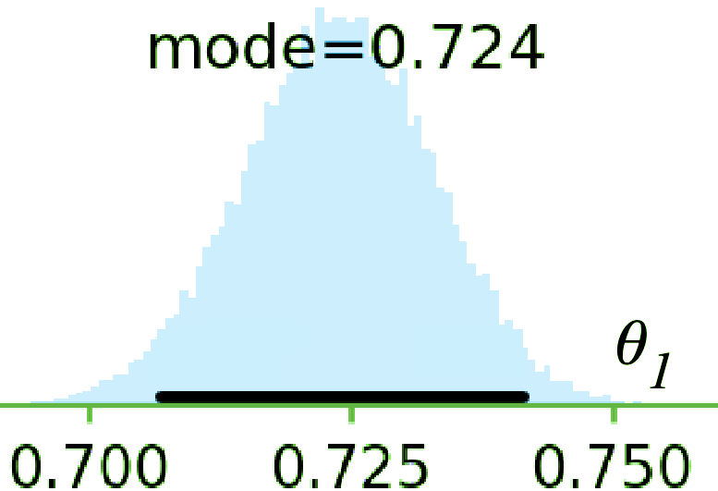
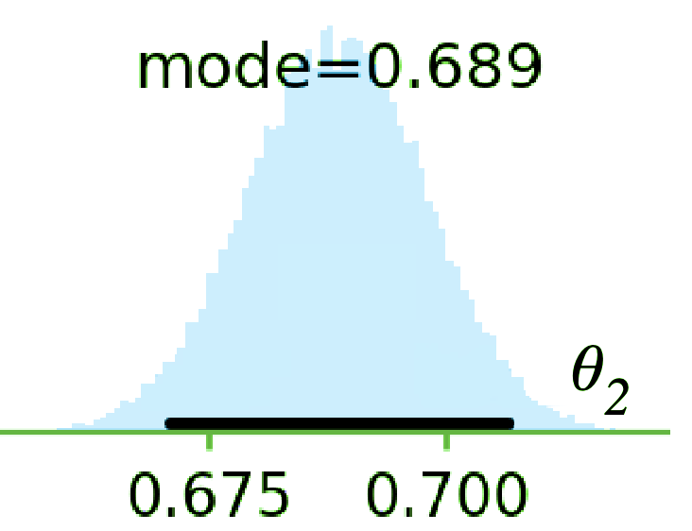
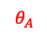
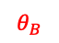
Posterior Intervals: Example
System | Accuracy
Ⓐ | 72.4
Ⓑ | 68.9
$$H_{1}: θ_{A}−θ_{B}>α$$
$$θ_{A}=Prob(Y=1)$$
Ⓐ
$$θ_{A}$$
$$0, 1, 1, 0,…$$
$$θ_{B}=Prob(Y=1)$$
Ⓑ
$$0, 0, 0, 1,…$$
$$θ_{B}$$
$$P\left(Y | Θ\right)$$
⊕
$$P\left(Θ | Y\right)=\frac{P\left(Y | Θ\right) × P(Θ)}{P(Y)}$$
$$P\left(Θ\right)\sim uniform$$

Slide 151
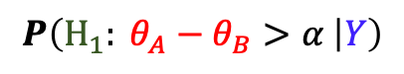
Posterior Intervals: Example
System | Accuracy
Ⓐ | 72.4
Ⓑ | 68.9
$$H_{1}: θ_{A}−θ_{B}>α$$
$$θ_{A}=Prob(Y=1)$$
Ⓐ
$$θ_{A}$$
$$0, 1, 1, 0,…$$
$$θ_{B}=Prob(Y=1)$$
Ⓑ
$$0, 0, 0, 1,…$$
$$θ_{B}$$
$$P\left(Y | Θ\right)$$
⊕
$$P\left(Θ | Y\right)=\frac{P\left(Y | Θ\right) × P(Θ)}{P(Y)}$$
$$P\left(H_{1}: θ_{A}−θ_{B}>α | Y\right)$$
$$P\left(Θ\right)\sim uniform$$

Slide 152
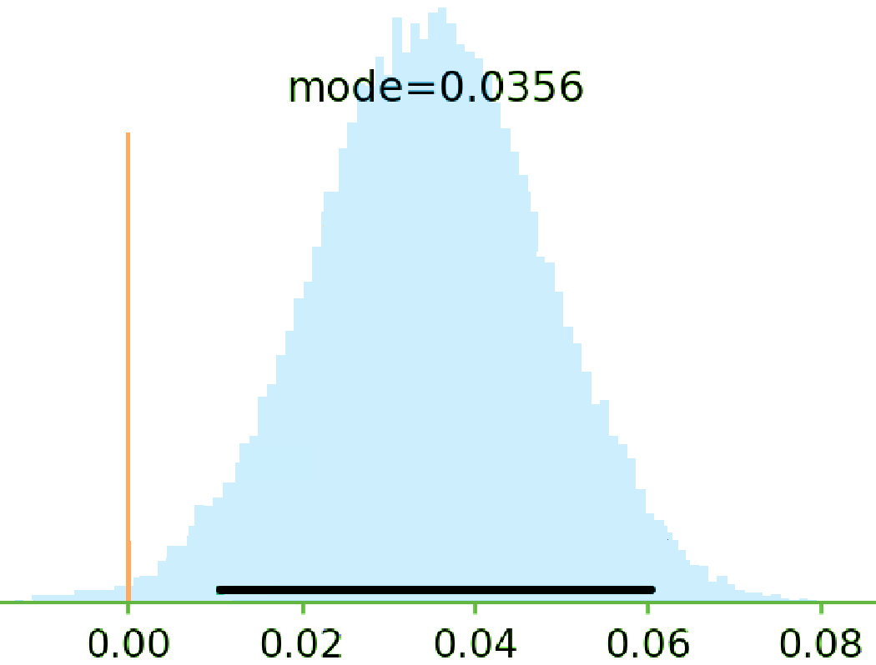
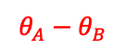
Posterior Intervals: Example
System | Accuracy
Ⓐ | 72.4
Ⓑ | 68.9
$$H_{1}: θ_{A}−θ_{B}>α$$
$$θ_{A}=Prob(Y=1)$$
Ⓐ
$$θ_{A}$$
$$0, 1, 1, 0,…$$
$$θ_{B}=Prob(Y=1)$$
Ⓑ
$$0, 0, 0, 1,…$$
$$θ_{B}$$
$$θ_{A}−θ_{B}$$
$$P\left(Y | Θ\right)$$
⊕
$$P\left(Θ | Y\right)=\frac{P\left(Y | Θ\right) × P(Θ)}{P(Y)}$$
$$P\left(H_{1}: θ_{A}−θ_{B}>α | Y\right)$$
$$P\left(Θ\right)\sim uniform$$

Slide 153
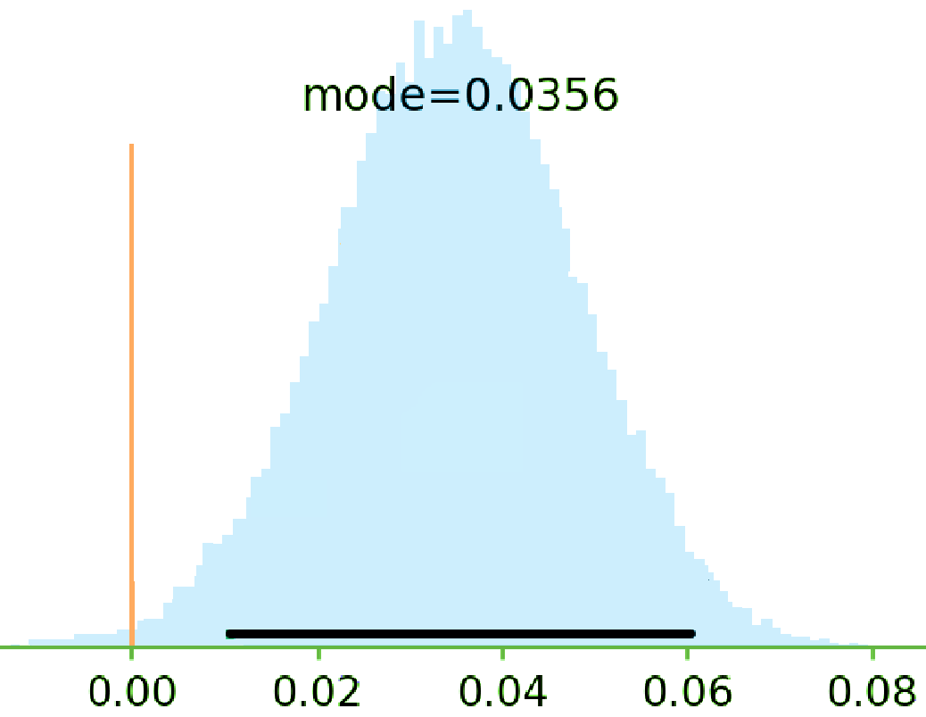
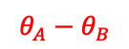
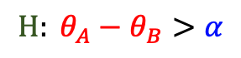
Posterior Intervals: Example
System | Accuracy
Ⓐ | 72.4
Ⓑ | 68.9
$$H: θ_{A}−θ_{B}>α$$
$$θ_{A}−θ_{B}$$

Slide 154
Posterior Intervals: Example
System | Accuracy
Ⓐ | 72.4
Ⓑ | 68.9
$$H: θ_{A}−θ_{B}>α$$
$$θ_{A}−θ_{B}$$

Slide 155
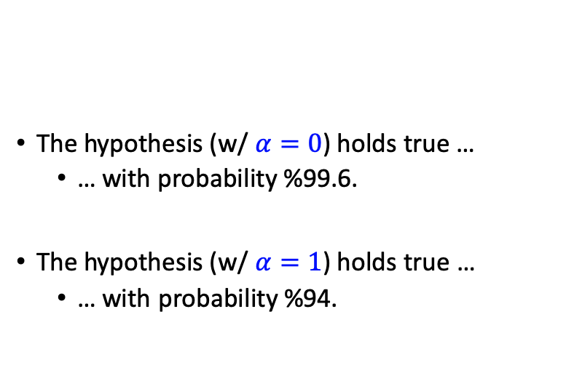
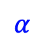
Posterior Intervals: Example
System | Accuracy
Ⓐ | 72.4
Ⓑ | 68.9
The hypothesis (w/ $α=0$) holds true …
… with probability %99.6.
The hypothesis (w/ $α=1$) holds true …
… with probability %94.
$$H: θ_{A}−θ_{B}>α$$
$$θ_{A}−θ_{B}$$
$$α$$

Slide 156
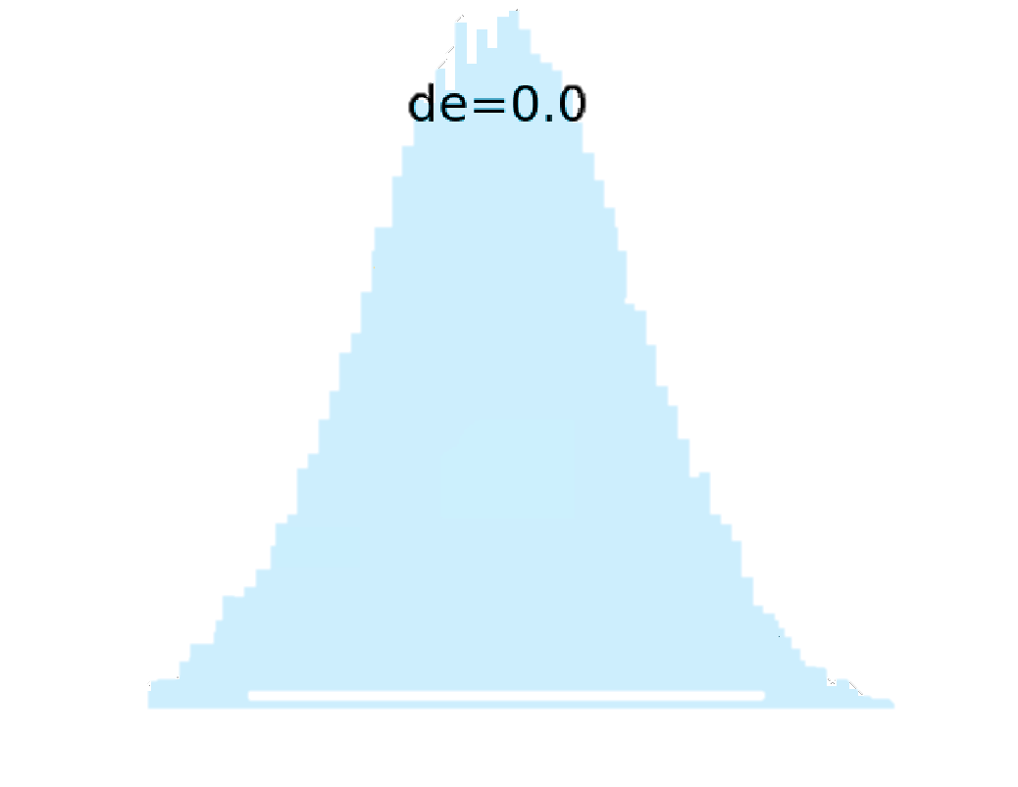
Posterior Intervals: Example
System | Accuracy
Ⓐ | 72.4
Ⓑ | 68.9
The hypothesis (w/ $α=0$) holds true …
… with probability %99.6.
The hypothesis (w/ $α=1$) holds true …
… with probability %94.
$$H: θ_{A}−θ_{B}>α$$
$$θ_{A}−θ_{B}$$
$$α$$

Slide 157
Posterior Intervals: Example
System | Accuracy
Ⓐ | 72.4
Ⓑ | 68.9
The hypothesis (w/ $α=0$) holds true …
… with probability %99.6.
The hypothesis (w/ $α=1$) holds true …
… with probability %94.
$$H: θ_{A}−θ_{B}>α$$
$$θ_{A}−θ_{B}$$
$$α$$

Slide 158
Posterior Intervals: Example
System | Accuracy
Ⓐ | 72.4
Ⓑ | 68.9
The hypothesis (w/ $α=0$) holds true …
… with probability %99.6.
The hypothesis (w/ $α=1$) holds true …
… with probability %94.
$$H: θ_{A}−θ_{B}>α$$
$$θ_{A}−θ_{B}$$

Slide 159
Posterior Intervals: Example
System | Accuracy
Ⓐ | 72.4
Ⓑ | 68.9
The hypothesis (w/ $α=0$) holds true …
… with probability %99.6.
The hypothesis (w/ $α=1$) holds true …
… with probability %94.
$$H: θ_{A}−θ_{B}>α$$
$$θ_{A}−θ_{B}$$

Slide 160
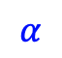
Posterior Intervals: Example
System | Accuracy
Ⓐ | 72.4
Ⓑ | 68.9
The hypothesis (w/ $α=0$) holds true …
… with probability %99.6.
The hypothesis (w/ $α=1$) holds true …
… with probability %94.
$$H: θ_{A}−θ_{B}>α$$
$$θ_{A}−θ_{B}$$
$$α$$

Slide 161
Posterior Intervals: Example
System | Accuracy
Ⓐ | 72.4
Ⓑ | 68.9
The hypothesis (w/ $α=0$) holds true …
… with probability %99.6.
The hypothesis (w/ $α=1$) holds true …
… with probability %94.
$$H: θ_{A}−θ_{B}>α$$
$$θ_{A}−θ_{B}$$
$$α$$

Slide 162
Posterior Intervals: Example
System | Accuracy
Ⓐ | 72.4
Ⓑ | 68.9
The hypothesis (w/ $α=0$) holds true …
… with probability %99.6.
The hypothesis (w/ $α=1$) holds true …
… with probability %94.
$$H: θ_{A}−θ_{B}>α$$
$$θ_{A}−θ_{B}$$
$$α$$

Slide 163
2nd Intermediate Summary
Frequentist
Bayesian
Binary Decision
Null-Hypothesis Significance Test
Bayes Factor
Uncertainty Estimations
Confidence Interval
Posterior Intervals

Slide 164
2nd Intermediate Summary
Provides probability estimates over hypothesis of interest.
Easier to interpret → less ambiguous.
Frequentist
Bayesian
Binary Decision
Null-Hypothesis Significance Test
Bayes Factor
Uncertainty Estimations
Confidence Interval
Posterior Intervals

Slide 165
2nd Intermediate Summary
Provides probability estimates over hypothesis of interest.
Easier to interpret → less ambiguous.
Provides a flexible framework
E.g., margin of superiority could incorporated in the definition of hypotheses.
This does not encourage binary decision-making.
Frequentist
Bayesian
Binary Decision
Null-Hypothesis Significance Test
Bayes Factor
Uncertainty Estimations
Confidence Interval
Posterior Intervals

Slide 166
2nd Intermediate Summary
Provides probability estimates over hypothesis of interest.
Easier to interpret → less ambiguous.
Provides a flexible framework
E.g., margin of superiority could incorporated in the definition of hypotheses.
This does not encourage binary decision-making.
Frequentist
Bayesian
Binary Decision
Null-Hypothesis Significance Test
Bayes Factor
Uncertainty Estimations
Confidence Interval
Posterior Intervals

Slide 167
Measures of [Un]Certainty
Frequentist
Bayesian
Binary Decision
Null-Hypothesis Significance Test
Bayes Factor
Uncertainty Estimations
Confidence Interval
Posterior Intervals
(Goodman, 2008; Wasserstein et al., 2016)

Slide 168
Measures of [Un]Certainty
P-values do not provide probability estimates on validity of hypotheses.
Frequentist
Bayesian
👎🏽
Binary Decision
Null-Hypothesis Significance Test
Bayes Factor
Uncertainty Estimations
Confidence Interval
Posterior Intervals
(Goodman, 2008; Wasserstein et al., 2016)

Slide 169
Measures of [Un]Certainty
P-values do not provide probability estimates on validity of hypotheses.
Frequentist
Bayesian
👎🏽
Binary Decision
Null-Hypothesis Significance Test
Bayes Factor
Uncertainty Estimations
Confidence Interval
Posterior Intervals
😑
(Goodman, 2008; Wasserstein et al., 2016)

Slide 170
Measures of [Un]Certainty
P-values do not provide probability estimates on validity of hypotheses.
Frequentist
Bayesian
👎🏽
👎🏽
Binary Decision
Null-Hypothesis Significance Test
Bayes Factor
Uncertainty Estimations
Confidence Interval
Posterior Intervals
😑
(Goodman, 2008; Wasserstein et al., 2016)

Slide 171
Measures of [Un]Certainty
P-values do not provide probability estimates on validity of hypotheses.
Posterior Intervals are interpretable in terms of post-data probabilities.
Frequentist
Bayesian
👎🏽
👎🏽
Binary Decision
Null-Hypothesis Significance Test
Bayes Factor
Uncertainty Estimations
Confidence Interval
Posterior Intervals
😑
👍🏽
(Goodman, 2008; Wasserstein et al., 2016)

Slide 172
Trends and Patterns in the field
Study NLP conference papers: ACL’18 papers (439 papers)
How many papers did use significance testing?
Frequentist
Bayesian
Binary Decision
Null-Hypothesis Significance Test
Bayes Factor
Uncertainty Estimations
Confidence Interval
Posterior Intervals

Slide 173
Trends and Patterns in the field
Study NLP conference papers: ACL’18 papers (439 papers)
How many papers did use significance testing?
Frequentist
Bayesian
73
Binary Decision
Null-Hypothesis Significance Test
Bayes Factor
Uncertainty Estimations
Confidence Interval
Posterior Intervals

Slide 174
Trends and Patterns in the field
Study NLP conference papers: ACL’18 papers (439 papers)
How many papers did use significance testing?
Frequentist
Bayesian
73
Binary Decision
Null-Hypothesis Significance Test
Bayes Factor
Uncertainty Estimations
Confidence Interval
Posterior Intervals
6

Slide 175
Trends and Patterns in the field
Study NLP conference papers: ACL’18 papers (439 papers)
How many papers did use significance testing?
Frequentist
Bayesian
73
0
Binary Decision
Null-Hypothesis Significance Test
Bayes Factor
Uncertainty Estimations
Confidence Interval
Posterior Intervals
6

Slide 176
Trends and Patterns in the field
Study NLP conference papers: ACL’18 papers (439 papers)
How many papers did use significance testing?
Frequentist
Bayesian
73
0
Binary Decision
Null-Hypothesis Significance Test
Bayes Factor
Uncertainty Estimations
Confidence Interval
Posterior Intervals
6
0

Slide 177
Trends and Patterns in the field
Study NLP conference papers: ACL’18 papers (439 papers)
How many papers did use significance testing?
Frequentist
Bayesian
73
0
Binary Decision
Null-Hypothesis Significance Test
Bayes Factor
Uncertainty Estimations
Confidence Interval
Posterior Intervals
Why?
6
0

Slide 179
Have you heard about "Bayesian Hypothesis Testing"?

Slide 180
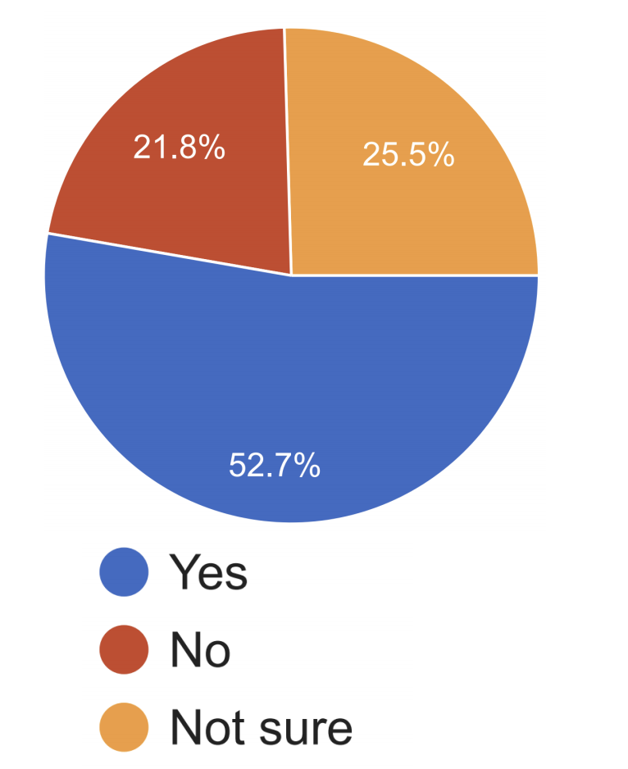
Have you heard about "Bayesian Hypothesis Testing"?

Slide 181
Have you heard about "Bayesian Hypothesis Testing"?
Do you know the definition of "Bayes Factor"?

Slide 182
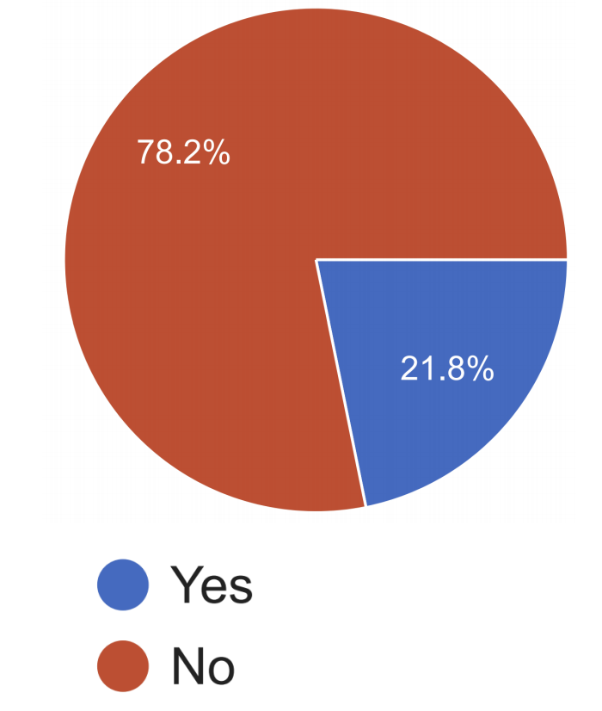
Have you heard about "Bayesian Hypothesis Testing"?
Do you know the definition of "Bayes Factor"?

Slide 183
Have you heard about "Bayesian Hypothesis Testing"?
Do you know the definition of "Bayes Factor"?
Many people did not know the definition of “Bayes Factor” and some only had “heard” about them. 🤔

Slide 184
Final Section: Malpractices & Suggestions
Frequentist
Bayesian
Binary/Categorical Decisions
Null-Hypothesis Significance Test
Bayes Factor
Uncertainty Estimations
Confidence Interval
Posterior Intervals

Slide 185
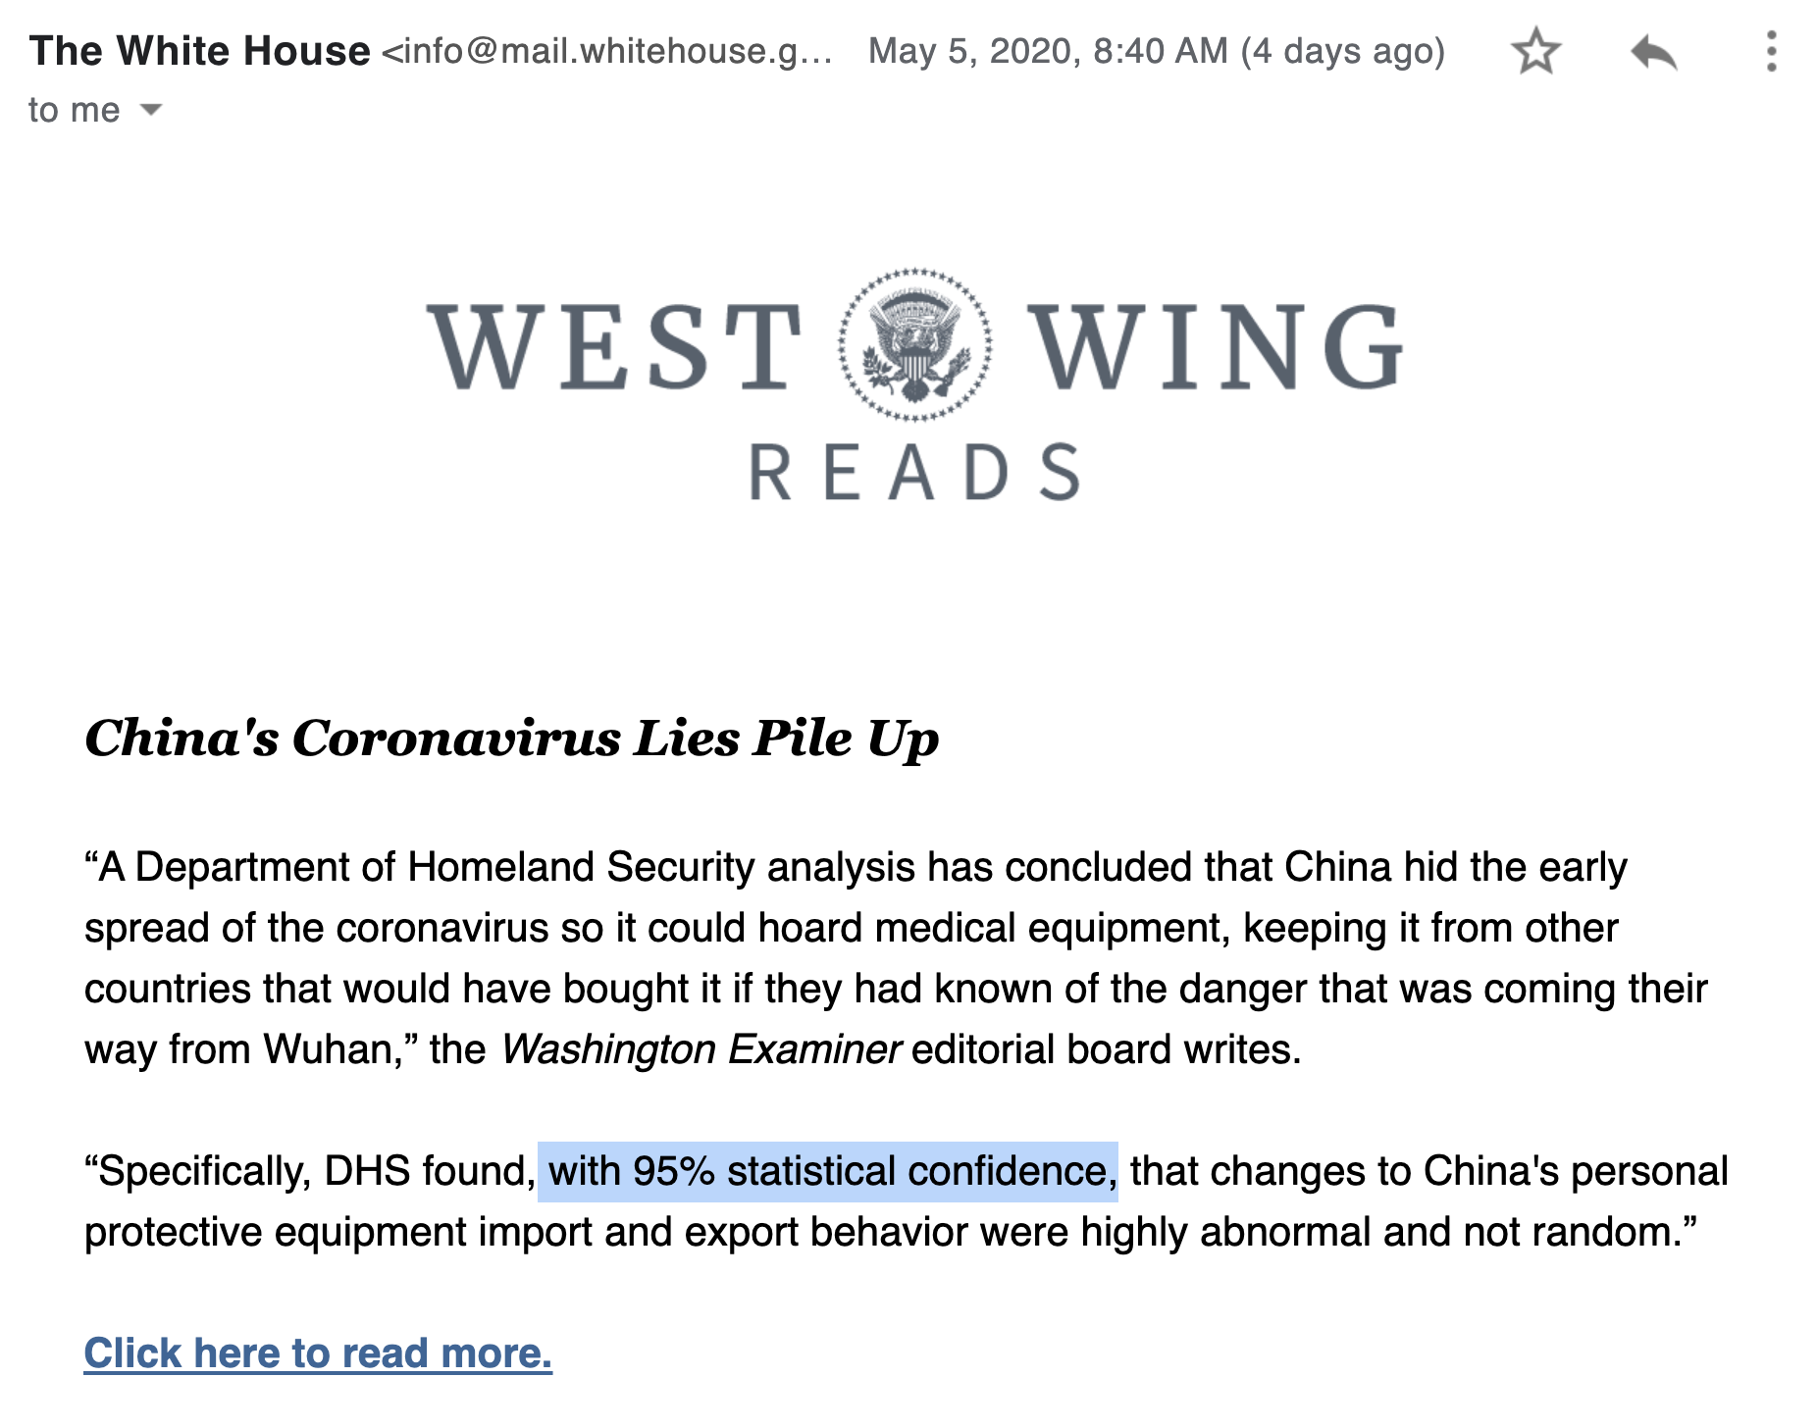
Ambiguous reporting

Slide 186
Ambiguous reporting
When referring to the results of significance testing, one should be mindful of how others are going to interpret it.

Slide 187
Ambiguity problem in interpreting “significance”

Slide 188
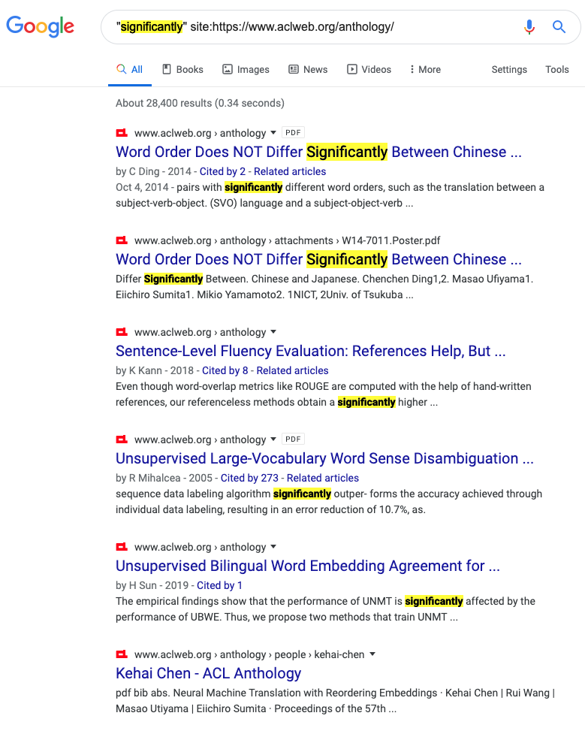
Ambiguity problem in interpreting “significance”

Slide 189
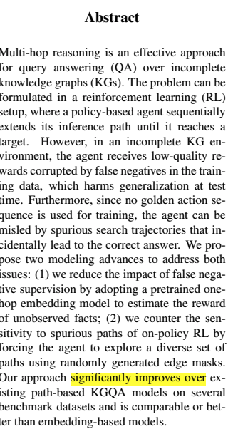
Ambiguity problem in interpreting “significance”

Slide 190
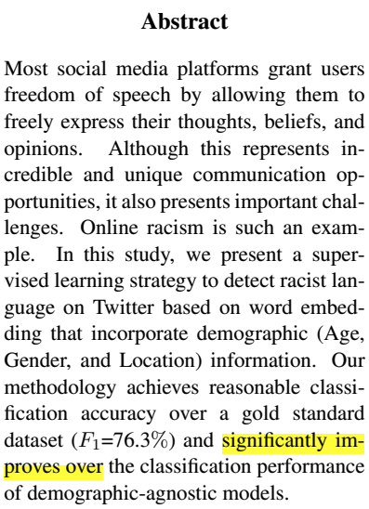
Ambiguity problem in interpreting “significance”

Slide 191
Ambiguity problem in interpreting “significance”

Slide 192
Ambiguity problem in interpreting “significance”
An NLP paper presents system-A and it compares it with a baseline system-B. In its “abstract” it writes: “... system-A significantly improves over system-B.” What are the right way(s) to interpret this (select all that applies)
It is expected that authors have performed some type of “hypothesis testing.”
It is expected that the authors have reported the performances of two systems on a dataset where system-A has a higher performance than system-B with a notable margin in the dataset.

Slide 193
Ambiguity problem in interpreting “significance”
An NLP paper presents system-A and it compares it with a baseline system-B. In its “abstract” it writes: “... system-A significantly improves over system-B.” What are the right way(s) to interpret this (select all that applies)
It is expected that authors have performed some type of “hypothesis testing.”
It is expected that the authors have reported the performances of two systems on a dataset where system-A has a higher performance than system-B with a notable margin in the dataset.

Slide 194
Ambiguity problem in interpreting “significance”
An NLP paper presents system-A and it compares it with a baseline system-B. In its “abstract” it writes: “... system-A significantly improves over system-B.” What are the right way(s) to interpret this (select all that applies)
It is expected that authors have performed some type of “hypothesis testing.”
It is expected that the authors have reported the performances of two systems on a dataset where system-A has a higher performance than system-B with a notable margin in the dataset.
83%

Slide 195
Ambiguity problem in interpreting “significance”
An NLP paper presents system-A and it compares it with a baseline system-B. In its “abstract” it writes: “... system-A significantly improves over system-B.” What are the right way(s) to interpret this (select all that applies)
It is expected that authors have performed some type of “hypothesis testing.”
It is expected that the authors have reported the performances of two systems on a dataset where system-A has a higher performance than system-B with a notable margin in the dataset.
83%
53%

Slide 196
The Usage of “Significance”: Our Recommendation
When referring to performing some type of “hypothesis testing,” use prefixes like “statistical”
When referring to big empirical improvements, use alternative terms like: “notable” or “remarkable.”

Slide 197
Tips and Suggestions
Frequentist
Bayesian
Binary Decision
Null-Hypothesis Significance Test
Bayes Factor
Define the research hypothesis you are after:
Uncertainty Estimations
Confidence Interval
Posterior Intervals
H1: Ⓐ and Ⓑ are inherently different, in the sense that if they were inherently identical, it would be highly unlikely to witness the observed 3.5% empirical gap.
H2: Ⓐ and Ⓑ are inherently different, since with probability at least 95%, the inherent accuracy of Ⓐ exceeds that of Ⓑ by at least 𝛼%.
…

Slide 198
Tips and Suggestions
The statements reporting p-value and confidence interval need to be precise.
… so that the results are not misinterpreted.
The term “significant” should be used with caution and clear purpose in order to not cause any misinterpretations.
better under a significance test != significantly better
One way to achieve this is by using adjectives “statistical” or “practical” before any (possibly inflected) usage of “significance.”

Slide 199
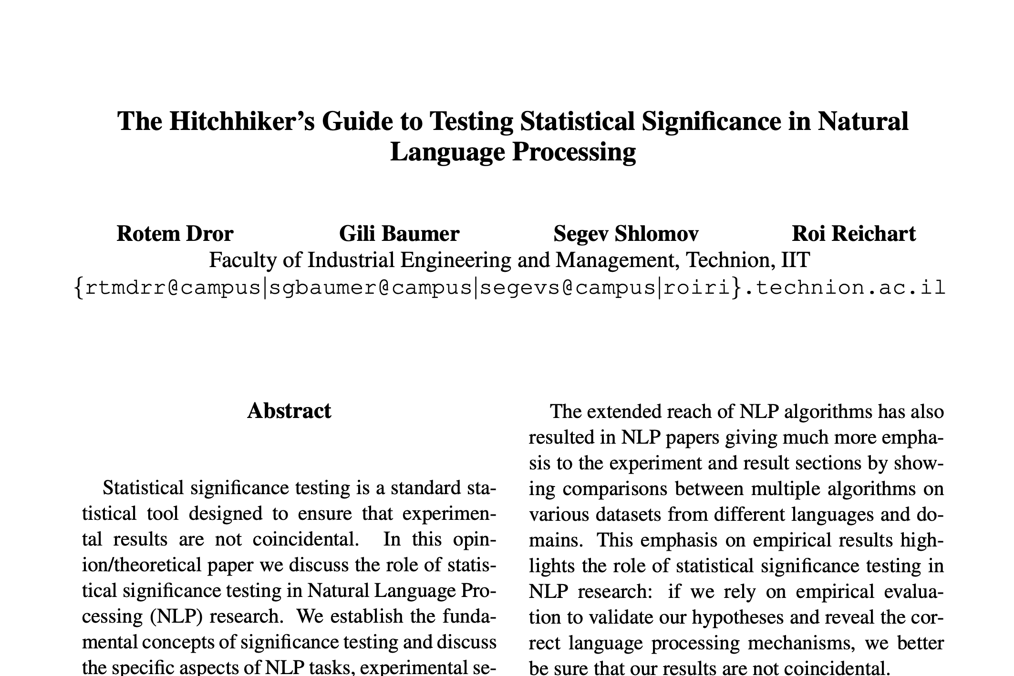
Tips and Suggestions
Frequentist
Bayesian
Binary Decision
Null-Hypothesis Significance Test
Bayes Factor
Uncertainty Estimations
Confidence Interval
Posterior Intervals
Lots of good tips about:
Selecting the right “test”
How to report your results.

Slide 200
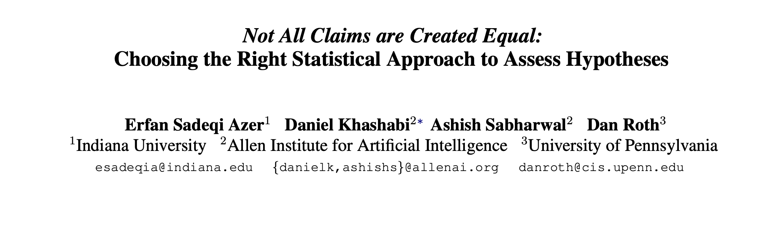
Tips and Suggestions
If using Bayesian tests:
https://github.com/allenai/HyBayes/

Slide 201
That’s it!

Slide 202
The Need for Assumptions
Frequentist
Bayesian
Binary Decision
Null-Hypothesis Significance Test
Bayes Factor
Uncertainty Estimations
Confidence Interval
Posterior Intervals

Slide 203
The Need for Assumptions
Which tests have assumptions?
Assumptions are necessary to perform any statistical tests.
“no free lunch”
Many of them are questionable!
Frequentist
Bayesian
Binary Decision
Null-Hypothesis Significance Test
Bayes Factor
Uncertainty Estimations
Confidence Interval
Posterior Intervals

Slide 204




Participants in our Survey

Slide 205

Participants in our Survey

Slide 206
Participants in Our Survey
“I can understand almost all the "statistical" terms I encounter in papers.”

Slide 207

Participants in Our Survey
“I can understand almost all the "statistical" terms I encounter in papers.”

Slide 208
Unintended Misleading Result by Iterative Testing

Slide 209
Unintended Misleading Result by Iterative Testing
Many tests are designed for a single-round experiment.
In practice researchers perform multiple rounds of experiments.
This is a major problem when using binary tests.
E.g., you can “hack” a p-value test, with enough repetitions.

Slide 210
Unintended Misleading Result by Iterative Testing
Expectation
Many tests are designed for a single-round experiment.
In practice researchers perform multiple rounds of experiments.
This is a major problem when using binary tests.
E.g., you can “hack” a p-value test, with enough repetitions.
Start
End

Slide 211
Unintended Misleading Result by Iterative Testing
Expectation
Many tests are designed for a single-round experiment.
In practice researchers perform multiple rounds of experiments.
This is a major problem when using binary tests.
E.g., you can “hack” a p-value test, with enough repetitions.
Start
End

Slide 212
Unintended Misleading Result by Iterative Testing
Reality
Expectation
Many tests are designed for a single-round experiment.
In practice researchers perform multiple rounds of experiments.
This is a major problem when using binary tests.
E.g., you can “hack” a p-value test, with enough repetitions.
Start
Start
???
End

Slide 213
Unintended Misleading Result by Iterative Testing
Reality
Expectation
Many tests are designed for a single-round experiment.
In practice researchers perform multiple rounds of experiments.
This is a major problem when using binary tests.
E.g., you can “hack” a p-value test, with enough repetitions.
Start
Start
???
End

